Slide 1
HTML, CSS, JavaScript Review
Course: CSC 436 Web Applications Instructor: Paul Duszak
Quarter: Fall 2022

Slide 2
Lecture Agenda
Syllabus Review
Homework Review
HTML Review
What is HTML?
Common structural & stylistic block and inline elements
HTML forms and input elements
CSS Review
What is CSS?
CSS rules and styling HTML
Bootstrap CSS Framework
JavaScript Review
Javascript Fundamentals
DOM

Slide 3
DePaul Club - Security Daemons
Caters to all students’ interest in:
Cyber Security
Web App Exploitation
Malware analysis
Network Forensics
Pen-testing
This club consists of students who compete in various cyber security competitions
Placed in the top 3% of the nation @ the National CCDC competition in Texas

Slide 4
D2L Introduction & Homework
D2L Introduction
Introduce yourself and answer the following questions:
Are you experienced with HTML, CSS, Javascript, Bootstrap, React, or Node?
Regarding web applications, what are you most interested in learning?
Homework
Assignment handout – D2L
Due next Tuesday, 5:30pm
Late policy, 2 weeks, -10% per week

Slide 5
HTML (Hypertext markup language)
Defines the structure and content of webpages
HTML elements create all of the sections, paragraphs, headings, lists, images, and links on a webpage
Elements enclose, wrap, or mark up different parts of content to make it appear or act in a certain way
There are multiple ways to deliver HTML files
Static
Server-side Rendering
Client-side Rendering

Slide 6
Browser’s Role in retrieving HTML
Browser issues a GET request for a particular page using HTTP protocol
In this case, server responds with HTML page
This sequence is not applicable to modern Single Page Applications (SPA)
Browser renders resultant HTML

Slide 7
Anatomy of an HTML Element
Opening Tag – Consists of the name of the element (in this example, p for paragraph), wrapped in opening and closing angle brackets
Content – Content of the element
Closing Tag – Similar to an opening tag, except a forward slash precedes the element name, indicates the end of the element
https://developer.mozilla.org/en-US/docs/Web/HTML/Element

Slide 8
Nesting elements
<p>My cat is <strong>very</strong> grumpy.</p>
<p>My cat is <strong>very grumpy.</p></strong>
HTML elements can be placed within other elements
Tags must be nested properly

Slide 9
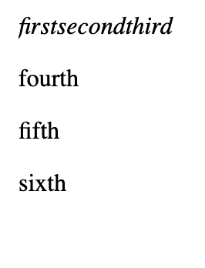
Element categories: Block and Inline
Block-level elements form a visible block on a page.
Block-level elements are usually structural elements on the page, such as a headings, paragraphs, lists, nav menu, or footers
Block-level elements do not nest in inline elements
Inline elements are contained within block-level elements
Inline element will not cause a new line to appear in the document.
HTML5 introduces significantly more categories
Markup:
<em>first</em><em>second</em><em>third</em> <p>fourth</p><p>fifth</p><p>sixth</p>
Output:
https://developer.mozilla.org/en-US/docs/Web/HTML/Block-level_elements https://developer.mozilla.org/en-US/docs/Web/HTML/Inline_elements

Slide 10
Void Elements
Not all elements have an opening tag, content, and a closing tag
Markup:
<img src="https://upload.wikimedia.org/wikipedia/commons/2/2f/Google_2015_logo.svg">
Output:
https://developer.mozilla.org/en-US/docs/Glossary/Empty_element

Slide 11
Element Attributes
Attributes contain extra information about the element that won't appear in the content
Content – Content of the element
Closing Tag – Similar to an opening tag, except a forward slash precedes the element name, indicates the end of the element
https://developer.mozilla.org/en-US/docs/Web/HTML/Attributes

Slide 12
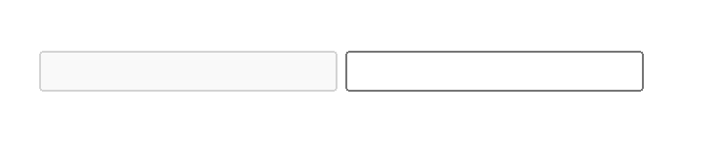
Boolean Attributes
Some attributes do not have values as they can only have one value
Markup:
<input type="text" disabled> <input type="text">
Output:
https://developer.mozilla.org/en-US/docs/Web/HTML/Attributes#boolean_attributes

Slide 13
Minimal HTML document
<doctype> – historical artifact, required for valid markup
<html> - root element which wraps all other elements
<head> - element contains everything to include in the page which is not content; character set declarations, stylesheets, javascript, and metadata
<meta charset> - indicates textual content on the pages is utf-8
<title> - sets page title
<body> - contains all the content that displays on the page
Markup:
<!DOCTYPE html> <html> <head> <meta charset="utf-8"> <title>My test page</title> </head> <body> <p>This is my page</p> </body> </html>

Slide 14
Basic Elements
<h1> … </h1> through <h6> ... </h6> | Heading – Defines a heading, descending order
<p> … </p> | Paragraph – Defines a paragraph block
<a href=“https://…”>Link Text</a> | Anchor tag – Defines a hyperlink Attributes: href – The absolute or relative URL the hyperlink points to
<img> | Image tag - used to display graphics (.jpeg, .png, .gif, etc) Attributes: src - the absolute or relative location of the image file alt - alternate Text for people who don't see images
<strong> … </strong> and <i> … </i> | Bold and Italic – Bolds and italicizes text respectively
<br> | Line Break – Starts a new line of text
<!-- comment --> | Comment – A comment
https://developer.mozilla.org/en-US/docs/Web/HTML/Attributes

Slide 15
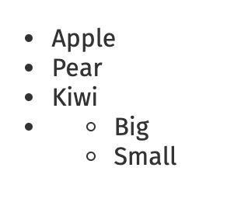
Unordered Lists
Markup:
Output:
<ul>
<li>Apple</li>
<li>Pear</li>
<li>Kiwi</li>
<li> <ul>
<li>Big</li>
<li>Small</li>
</ul> </li>
</ul>
https://developer.mozilla.org/en-US/docs/Web/HTML/Element/ul

Slide 16
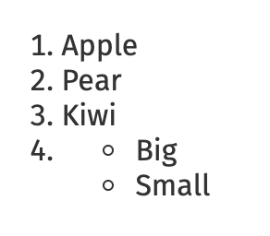
Ordered Lists
Markup:
Output:
<ol>
<li>Apple</li>
<li>Pear</li>
<li>Kiwi</li>
<li> <ul>
<li>Big</li>
<li>Small</li>
</ul> </li>
</ol>
https://developer.mozilla.org/en-US/docs/Web/HTML/Element/ol

Slide 17
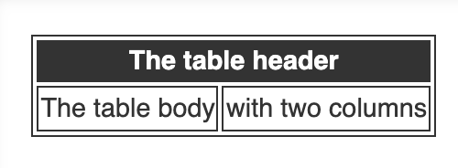
Tables
Markup:
Output:
<table>
<thead>
<tr>
<th colspan="2">The table header</th>
</tr>
</thead>
<tbody>
<tr>
<td>The table body</td>
<td>with two columns</td>
</tr>
</tbody>
</table>
https://developer.mozilla.org/en-US/docs/Web/HTML/Element/table

Slide 18
<div> and <span> elements
The <div> element is the generic block container for flow content.
Division or section
Groups and identifies one or more block-elements
Usually causes a line break before and after
The <span> element is a generic inline container
groups and identifies in-line elements (e.g. words)
no visual change by itself (no line break)
used to apply styles to parts of a text line, for example:
This <span style=”color: red”>red</span> apple.
https://developer.mozilla.org/en-US/docs/Web/HTML/Element/div https://developer.mozilla.org/en-US/docs/Web/HTML/Element/span

Slide 19
<link> element
The <link> tag defines the relationship between the current document and an external resource.
The <link> tag is most often used to link to external style sheets.
Linking external stylesheet:
<head> <link rel="stylesheet" href="styles.css"> </head>
https://developer.mozilla.org/en-US/docs/Web/HTML/Element/link

Slide 20
<script> element
The <script> tag is used to embed a client-side script (JavaScript).
The <script> element either contains JavaScript statements, or it points to an external script file through the “src” attribute.
Linking external javascript file:
<head> <script src=“bundle.js”> </head>
Inline JavaScript statements:
<head> <script>
document.getElementById("demo").innerHTML = "Hello JavaScript!";
</script> </head>
https://developer.mozilla.org/en-US/docs/Web/HTML/Element/script

Slide 21
HTML4 vs HTML5
Cleaner, more consistent and descriptive markup – semantic HTML
New elements header, nav, article, aside, section, figure, footer, but in html4, only div tag was available
Local storage
Native support for video and audio
Canvas 2D drawing area
https://developer.mozilla.org/en-US/docs/Learn/Accessibility/HTML

Slide 22
Forms
An HTML form provides data gathering functionality to a web page
Html provides the <form>…</form> tags with which an html form can be created to capture user input
<input> element
Defines an input area within a form.
Different ways of input are specified by “type” attribute.
text, radio, checkbox, password submit, reset, image, hidden, etc as its value
https://developer.mozilla.org/en-US/docs/Web/HTML/Element/form

Slide 23
Text input
<input type=“text” name=“text-id” value=“Search”>
It presents the user with a prompt for a single line of text. These fields are commonly used for a name address, email address, country, postal code, etc
Attributes:
Name: to label the content. This name is not visible to the user and must be unique within the form.
Value: to supply initial text to the txt field and is optional. The content of this attribute will be shown on the text field, unless the user changes it.
https://developer.mozilla.org/en-US/docs/Web/HTML/Element/input/text

Slide 24
Password input
<input type=“password” name=“password-id”>
Password fields are similar to the text fields, except the content of the field are not visible on the screen. It displays **** instead of the actual input
Attributes:
Name: to label the content. This name is not visible to the user and must be unique within the form.
Value: to supply initial text to the txt field and is optional. The content of this attribute will be shown on the text field, unless the user changes it.
https://developer.mozilla.org/en-US/docs/Web/HTML/Element/input/password

Slide 25
Radio Button input
<input type=“radio” name=“radio-id” value=“choice-id” checked>
These are mutually exclusive i.e. they allow the user to choose one of the several options. Selecting one turns the other off.
Attributes:
Value: it is the value assigned by the user. Each radio button must be assigned a value
Checked: causes the radio button to be on when the form is first created
https://developer.mozilla.org/en-US/docs/Web/HTML/Element/input/radio

Slide 26
Checkbox input
<input type=“checkbox” name=“box-id” value=“choice-id” checked>
An input tag with attribute type=“checkbox” offers the user an “on” or “off” switch. Each check box works independently from the other, visitor can select or deselect any combination of checkboxes Attributes:
Value: it is the value assigned by the user. Each radio button must be assigned a value
Checked: causes the radio button to be on when the form is first created
https://developer.mozilla.org/en-US/docs/Web/HTML/Element/input/checkbox

Slide 27
Drop down list
<select name=“text-id” >
<option value=“choice-id1” selected>text-label1</option>
<option value=“choice-id2” selected>text-label2</option>
<option value=“choice-id3” selected>text-label3</option>
</select>
A pull down menu lets the user select one choice out of many possible choices
All choices are not visible on screen, they are hidden, unless “multiple” attribute is specified in the select tag
https://developer.mozilla.org/en-US/docs/Web/HTML/Element/select

Slide 28
Docs - MDN HTML Web Docs
Provides a comprehensive list of HTML elements
Provides detailed description of element purpose, attributes, usage, and compatibility
Metadata Elements | https://developer.mozilla.org/en-US/docs/Web/HTML/Element#document_metadata
Semantic Sectioning | https://developer.mozilla.org/en-US/docs/Web/HTML/Element#content_sectioning
Text Content | https://developer.mozilla.org/en-US/docs/Web/HTML/Element#text_content
Text Styling | https://developer.mozilla.org/en-US/docs/Web/HTML/Element#inline_text_semantics
Multimedia | https://developer.mozilla.org/en-US/docs/Web/HTML/Element#image_and_multimedia
Tables | https://developer.mozilla.org/en-US/docs/Web/HTML/Element#table_content
Forms | https://developer.mozilla.org/en-US/docs/Web/HTML/Element#forms

Slide 29
Cascading Style Sheets (CSS)
A style sheet contains a list of rules about how elements appear on a page.
Consists of a selector and a declaration block:
Selectors tell which markup elements the style applies to.
A declaration block is a list of property and value pairs that define the style.
Can be embedded inside the HTML or linked as a separate document.
https://developer.mozilla.org/en-US/docs/Web/CSS

Slide 30
Separation of Content and Presentation
Content
Use tags like <div> , <h1>, <h2>, <p>, <em>, <li>, etc to indicate the structure of your pages
Presentation
Use a CSS style sheet to determine how the tags are formatted
Advantage of separation
Changing the formatting only requires editing the style sheet

Slide 31
Anatomy of a CSS Rule
Selector - which part of the document does this rule apply to
body {
font-family: arial, sans-serif;
font-size: 100%;
}
Property - which aspect of CSS are we changing
Value - What are we setting the property to

Slide 32
CSS Tags and Attributes
Two structural tags are primarily used for handling styling
<div> - A block tag (breaks justification)
<span> - An inline tag that does not break justification
There are two attributes with special meaning to CSS
id - Marks a unique block within the document for styling (use only once)
class - Marks a non-unique tag within the document for styling (multi-use)

Slide 33
DIV as a container
<div>
<p>This is a paragraph inside a div.</p>
<p>So is this.</p>
</div>
The ‘id’ attribute on the tag allows us to uniquely mark a div in a document.
<div id="header">
<ul>
<li><a href="sites.htm">Sites</a></li>
</ul>
</div>
div stands for division as it allows us to divide our page into parts or sections and then do something different with each “section”.

Slide 34
Styling a block with “id”
An id identifier identifies a particular block - only one in a document
Everything within block
Paragraphs within block
#footer {
font-style: italic;
font-family: Times, serif;
}
#footer p {
font-style: italic;
font-family: Times, serif;
}
<div id="footer">
<a href=“/terms-of-use”>Terms of Use</a>
<p>Copyright 2021</p>
</div>

Slide 35
Styling a block with “class”
A class identifier can be used many times in a document
.fun {
color: #339999;
font-family: Georgia, Times, serif;
letter-spacing: 0.05em;
}
<p class="fun">A man walks into a bar; you would've thought he'd see it coming!</p>
<p>Have a nice day.<p>
<p class=”fun”>More fun stuff</p>

Slide 36
Multiple tags with the same styling
h1, h2, h3 {
color: yellow;
background-color: black;
}
#header, #footer{
color: yellow;
background-color: black;
}

Slide 37
CSS Box Model
A box that wraps around every HTML element; allows us to add a border around elements, and to define space between elements
Content - The content of the box, where text and images appear
Padding - Clears an area around the content. The padding is transparent
Border - A border that goes around the padding and content
Margin - Clears an area outside the border. The margin is transparent

Slide 38
CSS Properties
There are many different CSS properties which can be adjusted
https://developer.mozilla.org/en-US/docs/Web/CSS/CSS_Properties_Reference

Slide 39
Three ways to add style rules
Inline Style - Add style information to a tag
Embedded Style - Add style information to the document at the beginning
External Style Sheet - Put all of your style in an external file

Slide 40
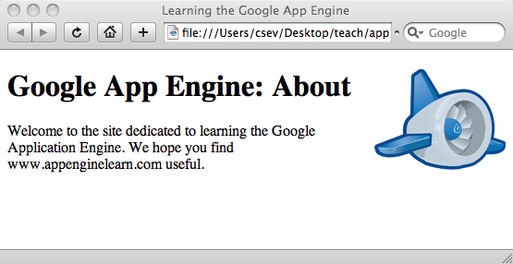
Inline Styles
<h1>
<img src="appengine.jpg" width="142" height="109“
alt="Google App Engine Logo“
style="float:right"/>
Google App Engine: About</h1>
<p>
Welcome to the site dedicated to
learning the Google Application Engine.
We hope you find
www.appenginelearn.com useful.
</p>

Slide 41
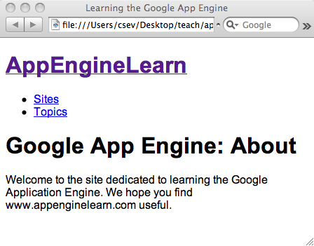
Embedded Style
<html> <head>
<title>Learning the Google App Engine</title> <style type="text/css">
body {
font-family: arial, sans-serif;
}
</style>
</head>
<body>
<h1><a href="index.htm">
AppEngineLearn</a></h1>
<ul>
<li><a href="sites.htm">Sites</a></li> <li><a href="topics.htm" >Topics</a></li> </ul>

Slide 42
External Styles
<html>
<head>
<title>Learning the Google App Engine</title>
<link type="text/css" rel="stylesheet" href="glike.css"> </head>
<body>
<h1><a href="index.htm">
AppEngineLearn</a></h1>
<ul>
<li><a href="sites.htm">Sites</a></li>
<li><a href="topics.htm" >Topics</a></li>
</ul>

Slide 43
CSS Frameworks - Responsive Web Design
Responsive web design is about creating web sites which automatically adjust themselves to look good on all devices, from small phones to large desktops
Bootstrap is the most popular HTML, CSS, and JavaScript framework for developing responsive, mobile-first web sites
Benefits:
Cross-browser capable
Mobile-ready
Get layout created quickly
Many snippets are widely available

Slide 44
What is Bootstrap?
Bootstrap is a free front-end framework for faster and easier web development
Bootstrap includes HTML and CSS based design templates for typography, forms, buttons, tables, navigation, modals, image carousels and many other, as well as optional JavaScript plugins
Bootstrap also gives you the ability to easily create responsive designs

Slide 45
Where to Get Bootstrap?
There are two ways to start using Bootstrap on your own web site.
Download Bootstrap from getbootstrap.com
If you want to download and host Bootstrap yourself, go to getbootstrap.com, and follow the instructions there.
Include Bootstrap from a CDN
If you don't want to download and host Bootstrap yourself, you can include it from a CDN (Content Delivery Network).
MaxCDN provides CDN support for Bootstrap's CSS and JavaScript. You must also include jQuery.
NPM package registry

Slide 46
Bootstrap CDN
You must include the following Bootstrap’s CSS, JavaScript, and jQuery from MaxCDN into your web page.
<!-- Latest compiled and minified Bootstrap CSS --> <link rel="stylesheet"href="https://maxcdn.bootstrapcdn.com/bootstrap/3.3.7/css/bootstrap.min.css">
<!-- Latest compiled Bootstrap JavaScript --> <script src="https://maxcdn.bootstrapcdn.com/bootstrap/3.3.7/js/bootstrap.min.js"></script>
<!-- latest jQuery library --> <script src="https://code.jquery.com/jquery-latest.js"></script>
Advantage of using the Bootstrap CDN:
Many users already have downloaded Bootstrap from MaxCDN when visiting another site. As a result, it will be loaded from cache when they visit your site, which leads to faster loading time. Also, most CDN's will make sure that once a user requests a file from it, it will be served from the server closest to them, which also leads to faster loading time.

Slide 47
Create Web Page with Bootstrap (1)
Add the HTML5 doctype
Bootstrap uses HTML elements and CSS properties that require the HTML5 doctype.
Always include the HTML5 doctype at the beginning of the page, along with the lang attribute and the correct character set:
<!DOCTYPE html>
<html lang="en"> <head> <meta charset="utf-8"> </head>
</html>

Slide 48
Create Web Page with Bootstrap (2)
Bootstrap is mobile-first
Bootstrap is designed to be responsive to mobile devices. Mobile-first styles are part of the core framework.
To ensure proper rendering and touch zooming, add the following <meta> tag inside the <head> element:
<meta name="viewport" content="width=device-width, initial-scale=1">
The width=device-width part sets the width of the page to follow the screen-width of the device (which will vary depending on the device).
The initial-scale=1 part sets the initial zoom level when the page is first loaded by the browser.

Slide 49
Create Web Page with Bootstrap (3)
Containers
Bootstrap also requires a containing element to wrap site contents.
There are two container classes to choose from:
The .container class provides a responsive fixed width container
The .container-fluid class provides a full width container, spanning the entire width of the viewport

Slide 50
Bootstrap Grids
Bootstrap’s grid system allows up to 12 columns across the page.
If you do not want to use all 12 columns individually, you can group the columns together to create wider columns:
<div class="col-md-12">Span 12 columns</div>
<div class="col-md-6">Span 6</div><div class="col-md-6">Span 6</div>
<div class="col-md-4">Span 4</div><div class="col-md-8">Span 8</div>
<div class="col-md-4">Span 4</div><div class="col-md-4">Span 4</div> <div class="col-md-4">Span 4</div>
Bootstrap's grid system is responsive, and the columns will re-arrange automatically depending on the screen size.
https://getbootstrap.com/docs/5.0/examples/grid/#containers

Slide 51
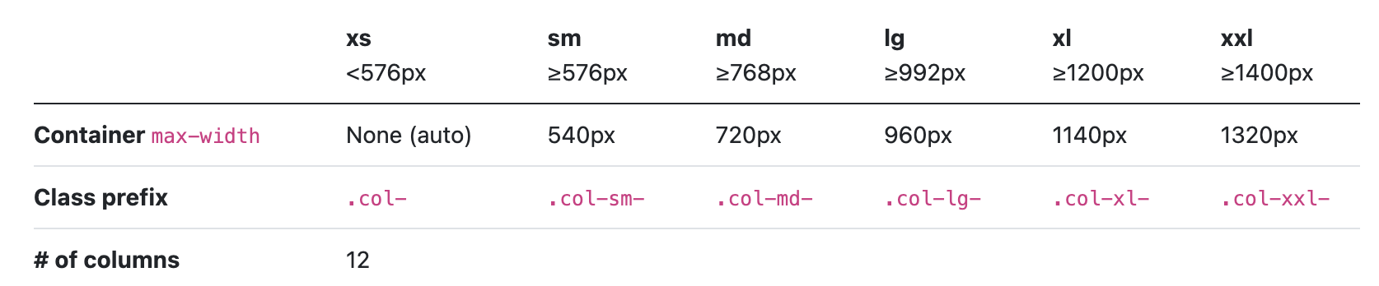
Grid Classes
Bootstrap’s grid system can adapt across all six default breakpoints, and any breakpoints you customize. The six default grid tiers are as follow:
Extra small (xs)
Small (sm)
Medium (md)
Large (lg)
Extra large (xl)
Extra extra large (xxl)

Slide 52
Basic Structure of a Bootstrap Grid
<div class="row"> <div class="col-*-*"></div> </div> <div class="row"> <div class="col-*-*"></div> <div class="col-*-*"></div> <div class="col-*-*"></div> </div> <div class="row"> ... </div>
First; create a row (<div class="row">). Then, add the desired number of columns (tags with appropriate .col-*-*classes). Note that numbers in .col-*-* should always add up to 12 for each row.

Slide 53
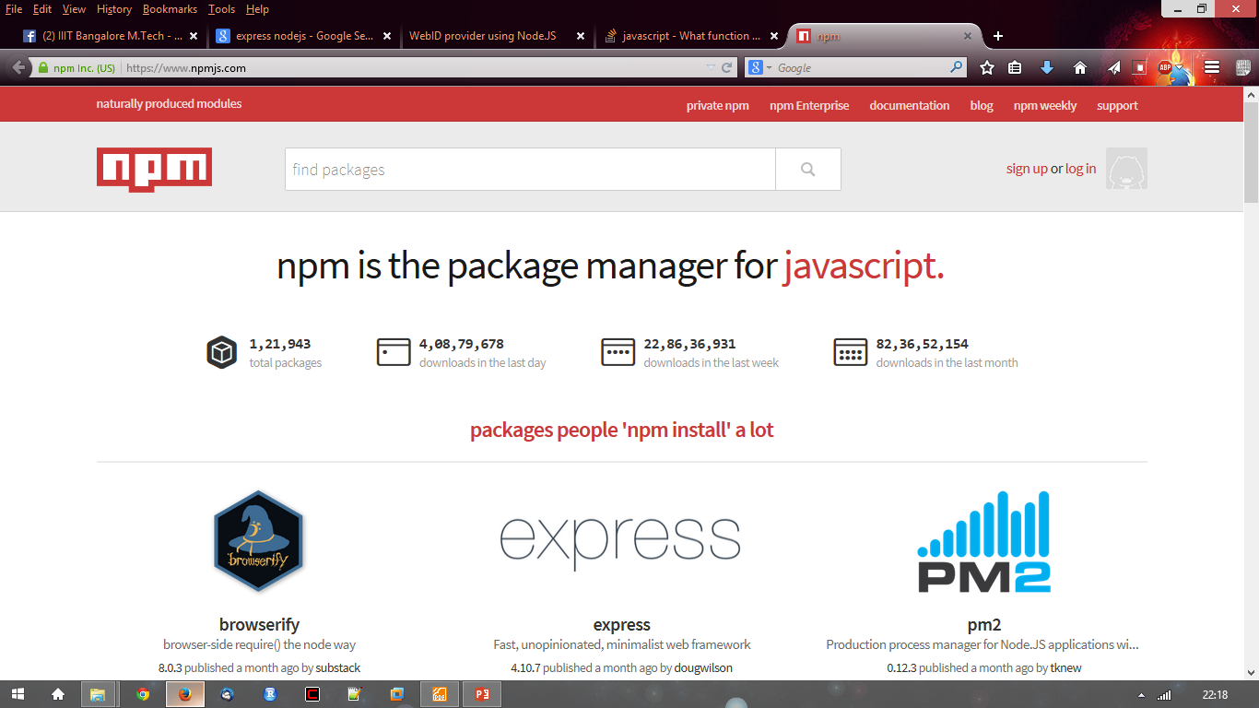
NPM
● https://npmjs.org/
● # of modules = 1,21,943

Slide 54
Node package.json
{
"name": "node-js-getting-started",
"version": "0.2.5",
"description": "A sample Node.js app using Express 4",
"engines": {
"node": "5.9.1"
},
"main": "index.js",
"scripts": {
"start": "node index.js"
},
"dependencies": {
"body-parser": "^1.16.1",
"cookie-parser": "^1.4.3",
"cool-ascii-faces": "1.3.4",
"ejs": "2.4.1",
"express": "^4.13.3",
"express-session": "^1.15.1",
"mongodb": "^2.2.24",
"multer": "^1.3.0",
"pg": "4.x",
"pug": "^2.0.0-beta11"
},
"repository": {
"type": "git",
"url": "https://github.com/heroku/node-js-getting-started"
},
"keywords": [
"node",
"heroku",
"express"
],
"license": "MIT"
}
Project information
• Name
• Version
• Dependencies
• Licence
• Main file
Etc...

Slide 55
Basic Usage of NPM
npm init
npm install [-g] <package>
Local vs global
npm update [-g]
Semantic versioning
npm uninstall [-g] <package>
More on NPM

Slide 56
Live Demo –
Create a Node Project
Add Bootstrap as dependency
Add Bootstrap example markup

Slide 57
Javascript Review
Topics:
const and let
classes and objects
this
Arrow functions
Destructuring
Spread Operator
Modules

Slide 58
Strict Mode
Change some default JavaScript behaviors to make it easier to spot errors, optimize performance, and migrate to future versions of ES
Put "use strict"; (or 'use strict';) before any statement in a script

Slide 59
Types
Boolean
Number
String
Null
Undefined
(Symbol)
Object
Primitive Types

Slide 60
Literals
Boolean: true, false
Number: 123, 4.56
String: "hello", 'world'
Null and Undefined: null, undefined
Template literal
Object literal

Slide 61
Variables and Constants
let x; // declare a variable x
x = 10; // now x is a number
x = 'abc'; // now x is a string
const y = 20; // y is a constant

Slide 62
Variable Scope
a = 10; // global scope
var b = 20; // function scope
let c = 30; // block scope
const d = 40; // block scope
Scope example
Global vs function vs block
Strict vs non-strict mode
Avoid using var or global variables

Slide 63
Template Literal
A.K.A. Template String
Example:
let a = 10;
let b = 20;
console.log( `${a}+${b} is ${a+b}` );
Expression

Slide 64
Object Literal
Valid JavaScript Identifier
(Variable Name)
{
make: 'Honda',
model: "Civic",
"Year": 2001,
'owner': {
name: "Chengyu"
}
}
String or Number
An object literal consists of zero or more key:value pairs called properties

Slide 65
JSON (JavaScript Object Notation)
Used as a data exchange format
Based on a subset of JavaScript syntax
Strings are double quoted
Property keys are strings
{
"make": "Honda",
"model": "Civic",
"year": 2001,
"owner": {
"name": "Chengyu"
}
}

Slide 66
Object Property
Valid JavaScript Identifier
(Variable Name)
String or Number
console.log( obj.make );
console.log( obj["make"] );
obj[0] = 10;
Properties can be dynamically added
What if there’s a variable make? ➔ Computed Property

Slide 67
Property Value Shorthand
let name = 'Joe';
let user = {
name: name,
age: 20
}
let name = 'Joe';
let user = {
name,
age: 20
}
Often used in object initializers, e.g.
function createUser(name, age) {
return {name, age};
}

Slide 68
Array
a = ["x", "y", "z"];
a.b = "hello";
a[100] = 10;
{
0: "x",
1: "y",
2: "z"
}
An array is a special object where array elements are stored as object properties
An array may have “holes” (i.e. undefined elements)
Array has built-in properties like length

Slide 69
Operators
All Java operators, e.g. +, -, =, && …
Strict equality/inequality: ===, !==
=== true if same type and same value
Type operators: typeof, instanceof
Object property operators: in, delete

Slide 70
Automatic Type Conversion
2 + 4/2
2 + 3/2
"2" + 3/2
3/2 + "2"
3/2 * "2"
3/2 + "two"
3/2 * "two"
0 == false
1 == true
"" == false
null == false
undefined == false
0 == ""
null == undefined
Pros and cons of automatic type conversion??

Slide 71
Statements
All common Java statements, e.g. if, for, while, switch, break, continue …
for..in loop iterate over object property keys
Strict equality check is used in switch statement
Semicolon is optional but highly recommended

Slide 72
Functions as First-class Citizens
In JavaScript, functions are actually objects
Assigned to a variable
Assigned as a property of an object
Function literals (a.k.a. function expressions, anonymous functions)
Passed as a function argument
Returned as a function result

Slide 73
Function Examples
function foo() {
alert("foo");
}
bar = function() {
alert("bar");
};
setTimeout( bar, 5000 );
setTimeout( function() {
alert("foobar");},
5000 )
Regular function
declaration
Function literal
Function assignment
Function as parameter
Function literal
as parameter

Slide 74
Function Arguments
function add(x,y) {
return x+y;
}
add(10,20);
add("10","20");
add(10);
add(10,20,30);
A special variable arguments hold all the arguments to a function
arguments is not an array but similar to an array, e.g. arguments.length, arguments[0], arguments[1], …

Slide 75
Arrow Functions
A.K.A. lambda expressions, lambdas
A more concise way to write function literals
Does not have its own this or arguments variables
function(a) {
return a*2
}
(a)=>{return a*2}
a=>a*2

Slide 76
Object Method Example
let user = {
name: 'Joe',
hello: function() {
console.log(`My name is ${this.name}`);
}
};
let user = {
name: 'Joe',
hello() {
console.log(`My name is ${this.name}`);
}
};

